Slide 1

Geographies of Underrecognition: Citation Disparities in Russian Studies
Katerina Guba, Elena Chechik, Angelika Tsivinskaya,
Artur Pecherskikh, Nikita Buravoy
Center for Institutional Analysis of Science & Education
European University at Saint Petersburg
Saint Petersburg, Russia

Slide 2
Why
are certain papers cited more?

Slide 3
What affects citations?
28 Factors
Paper related
Journal related
Author(s) related
Tahamtan, L. et al. (2016). Factors affecting number of citations: a comprehensive review of the literature. Scientometrics, 107, 1195-1225.

Slide 4
Geographical factor in citation inequality
“Model Cases” (Krause 2021, Jacobs & Mizrachi 2020)
Certain countries are treated as “canonical”
Research from other regions seen as “local” or “context-specific”
Home-bias (Baccini & Petrovich 2023, Qiu et al., 2024)
Scholars favor citing work from their own country
Baccini, A., & Petrovich, E. (2023). A global exploratory comparison of country self-citations, 1996–2019. PLOS ONE, 18(12),
Jacobs, J. A., & Mizrachi, N. (2020). International representation in U.S. social-science journals. American Sociological Review, 85(1), 45–70.
Krause, M. (2016). Western hegemony in the social sciences: Fields and model systems. Sociological Review, 64(2_suppl), 1–27.
Qiu, S., Steinwender, C., & Azoulay, P. (2024). Paper tiger? Chinese science and home bias in citations (No. w32468). National Bureau of Economic Research.

Slide 5
Data
15,078 papers
from 1990-2020
WoS (Social Sciences Citation Index)
selected with keyword list

Slide 6
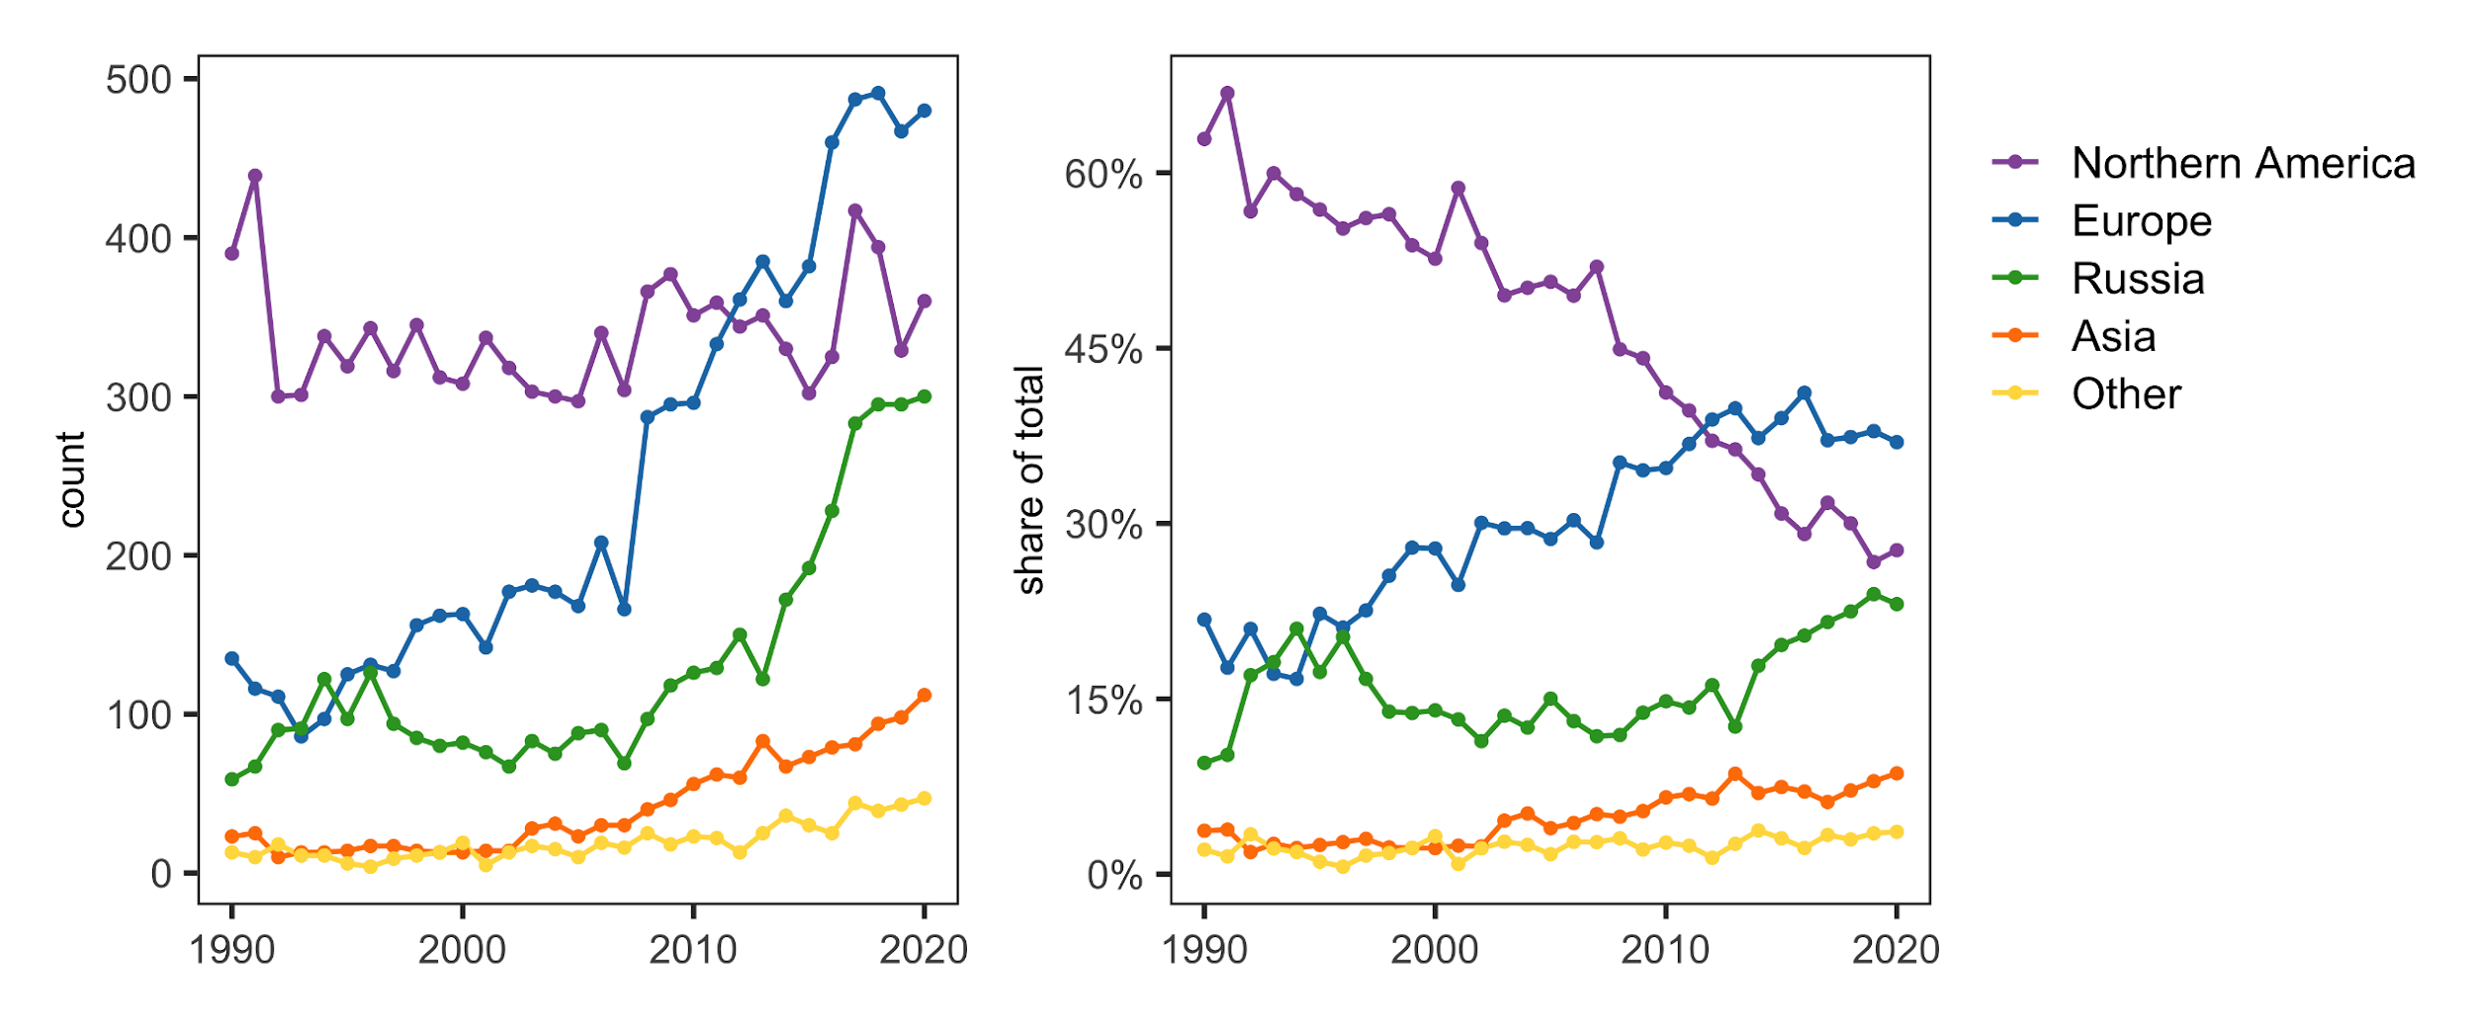
Contribution by regions

Slide 7
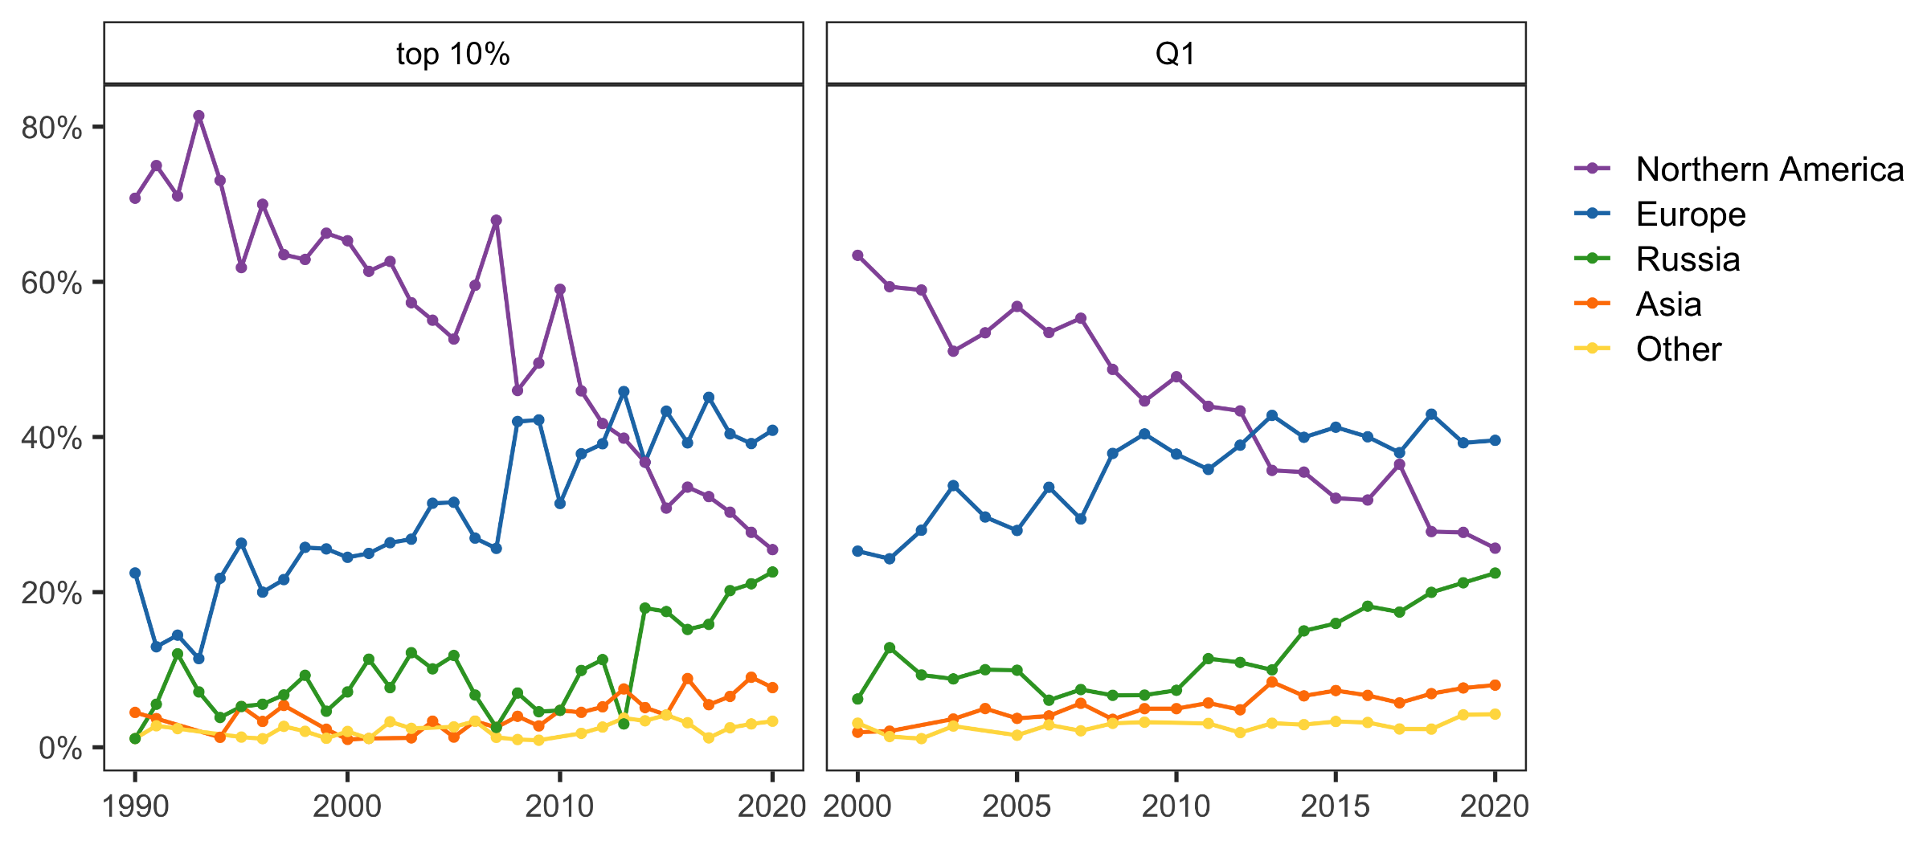
More highly cited papers from Europe and Russia, fewer from North America over time

Slide 8
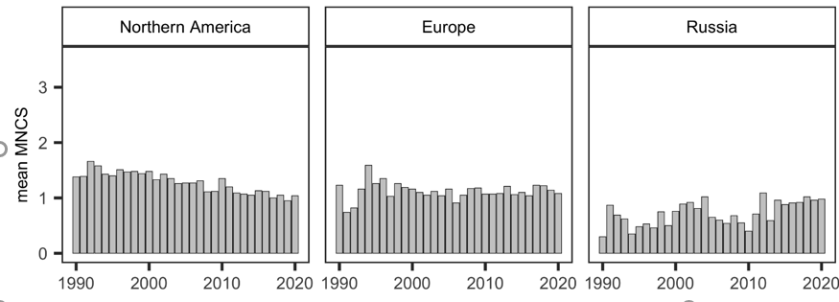
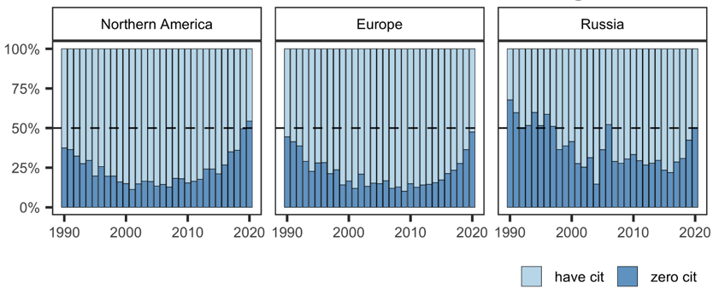
papers by authors from Russia are cited less

Slide 9
Inequality in Recognition
If
It is assumed that all publications are of equal quality
A common way to judge quality as average journal citation metrics (JIF, SJR, CiteScore, quartile)
Then
factors beyond the content of the work influence recognition

Slide 10
Variables
Dependent variable:
MNSC (binary) – the article’s average citations are above or below the global average
Independent variables:
SJR – journal quality
Type of collaboration
Number of authors
Year of publication
Region

Slide 11
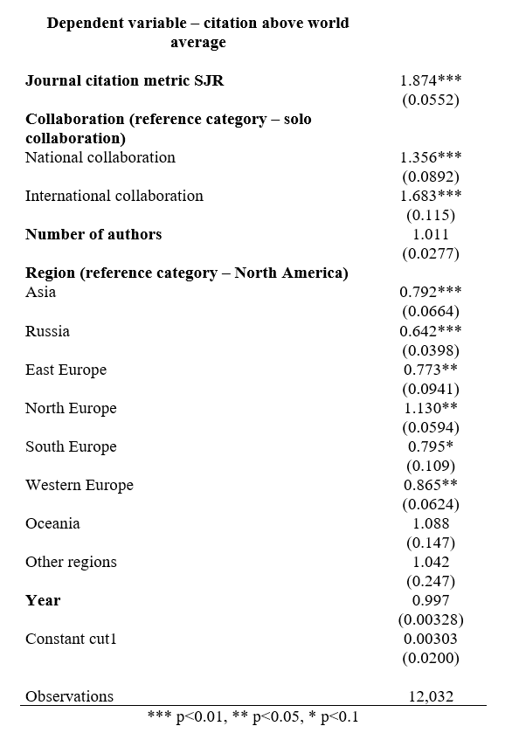
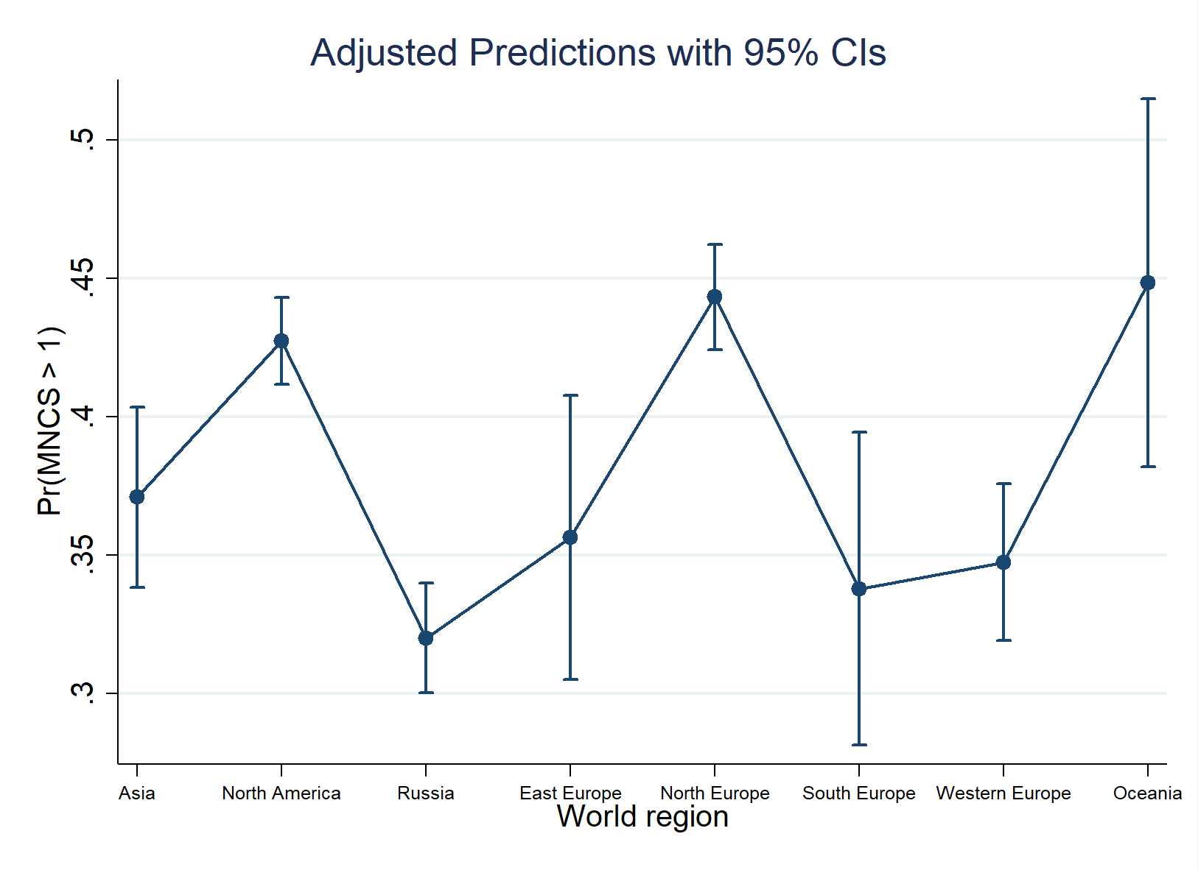
Probability of being cited above the world average is the lowest for papers from Russia compared to other regions

Slide 12
Summary
North America and Europe remain leaders in producing highly cited papers in Russian Studies, but they have swapped places
Russia started from a low baseline in global knowledge production in Russian Studies, but over 30 years has increased its presence by 1.5 times
However, the impact of its articles remains lower compared to other regions

Slide 13

For more …
Beyond Sentiment Analysis with ChatGPT: Classifying Authors' Perspectives on Russian Topics
Q&A
To contact me:
angelika.tsivinskaya@gmail.com

Slide 14
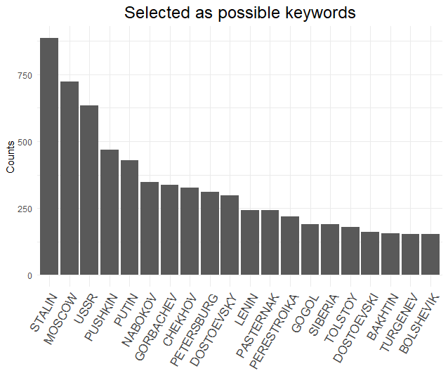

Slide 15
